Slide 1

CSE347: Information System Analysis And Design Section: 06 Equipment And Accessories Rental System Group: 5
Submitted By :
Muhammad Abdul Kayum
ID: 2023-2-60-082
Reduan Islam
ID: 2023-1-60-118
Md.Sadman Sakib Siam
ID: 2023-1-60-119
Md Ishaq
ID: 2023-1-60-031

Slide 2

Introduction
Community-based rental & sharing platform
Connects item owners with borrowers
Features: listings, booking, notifications, reviews
Promotes cost saving & sustainability

Slide 3

Objectives
Provide easy access to shared resources
Reduce unnecessary purchases
Create opportunities for extra income

Slide 4
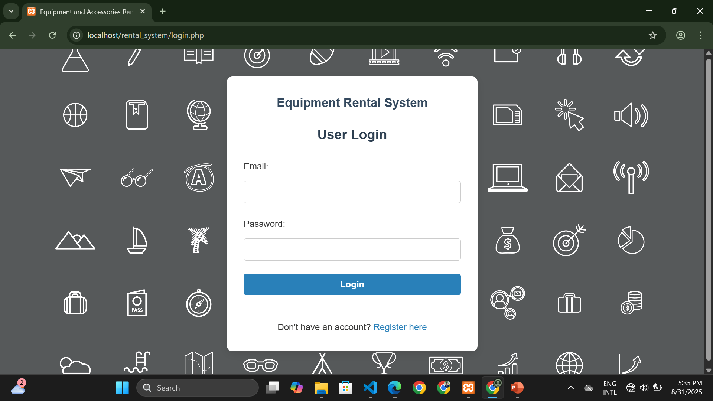

Slide 5
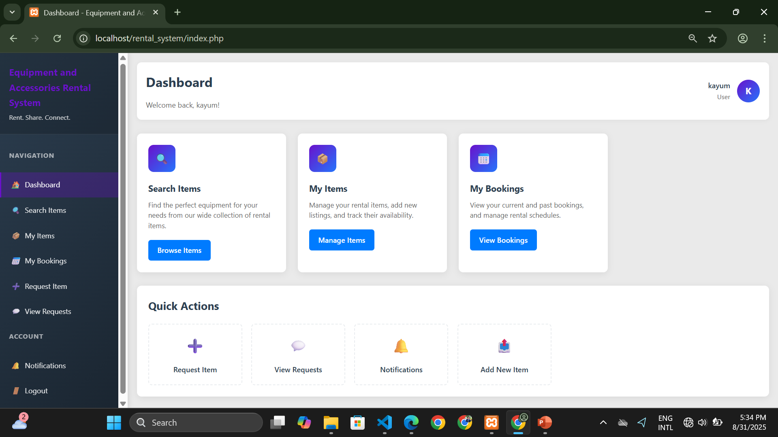

Slide 6
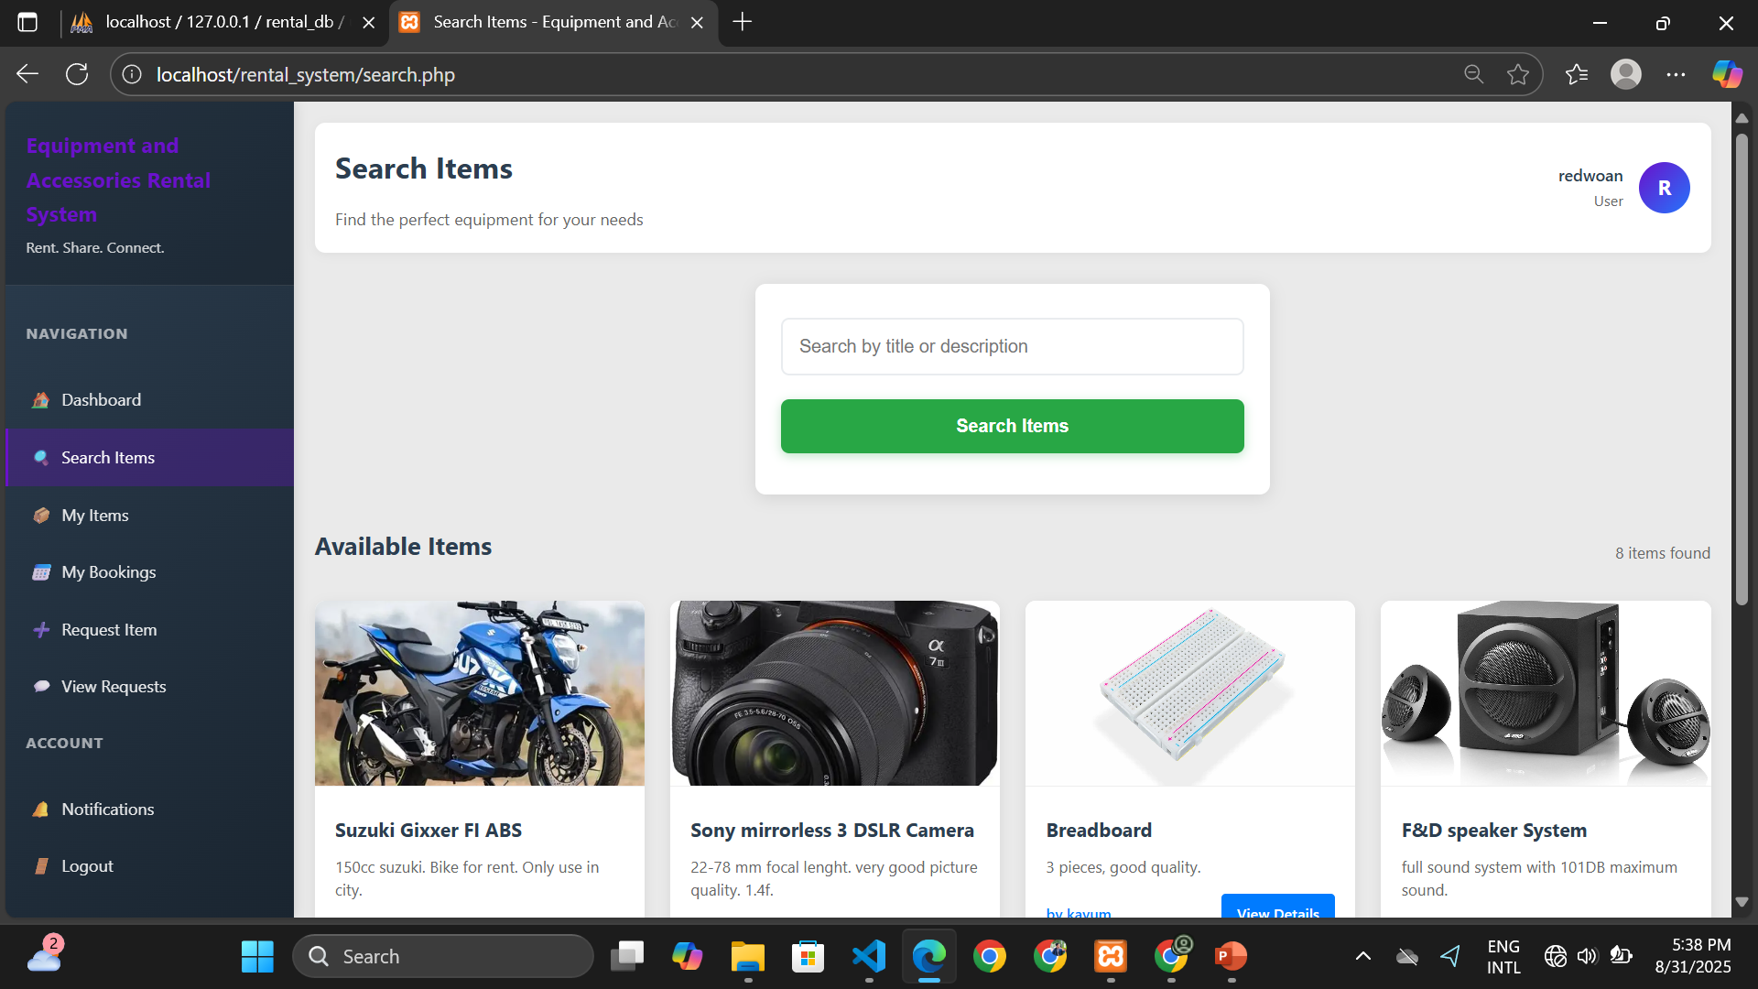

Slide 7
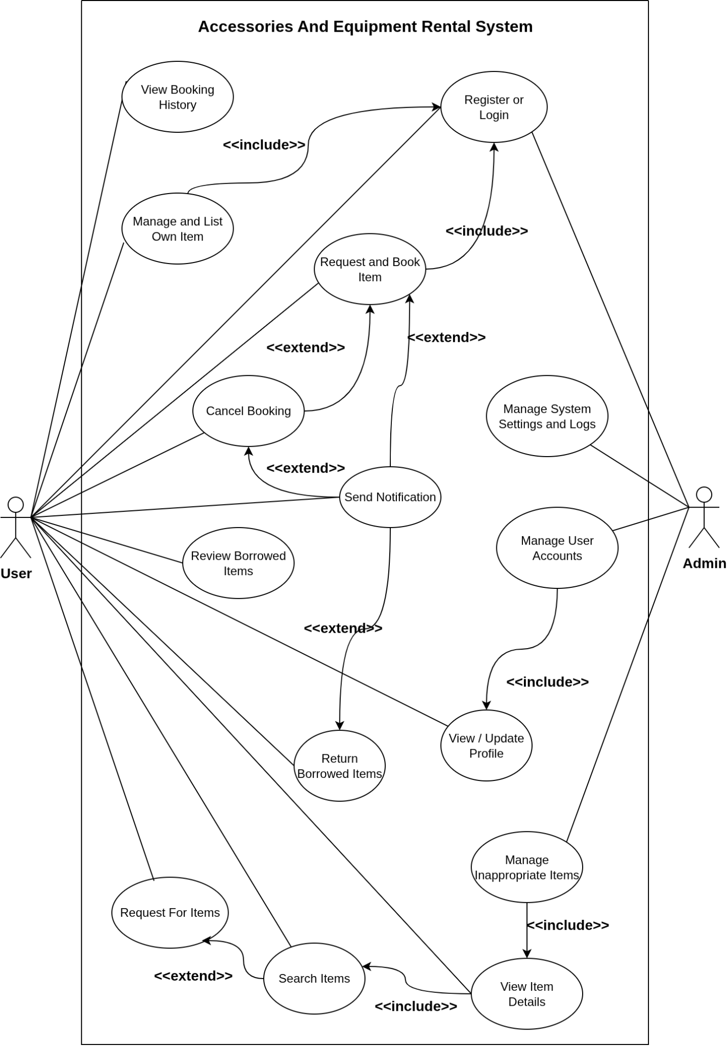

Slide 8
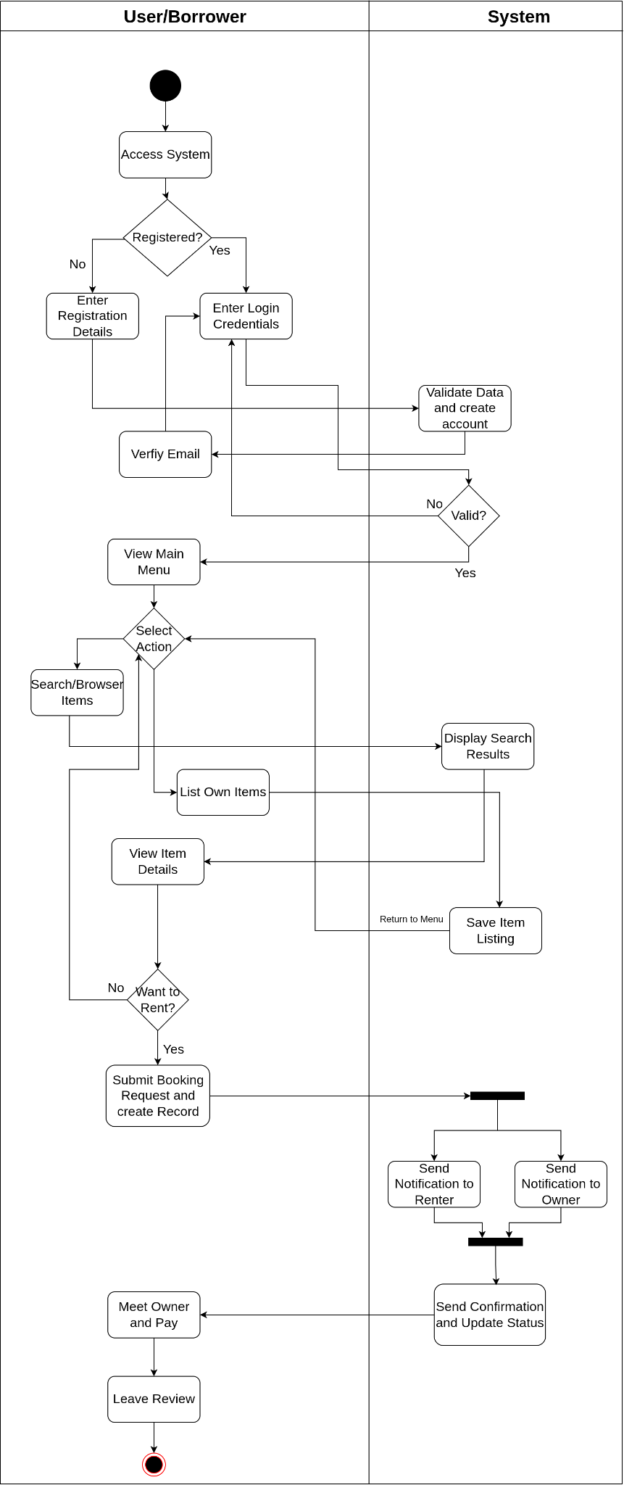
Activity Diagram for Borrower
contains the borrowing process by user
Includes the system activity

Slide 9
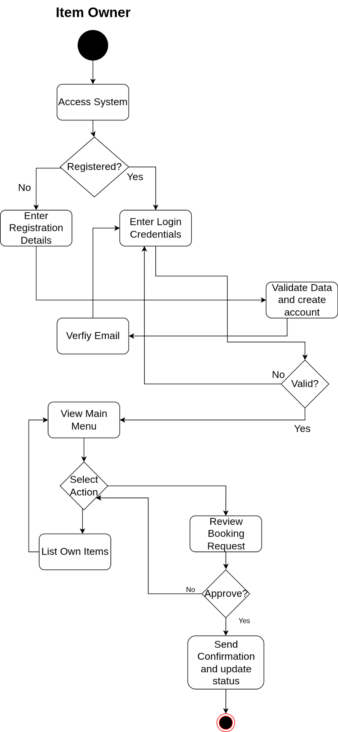
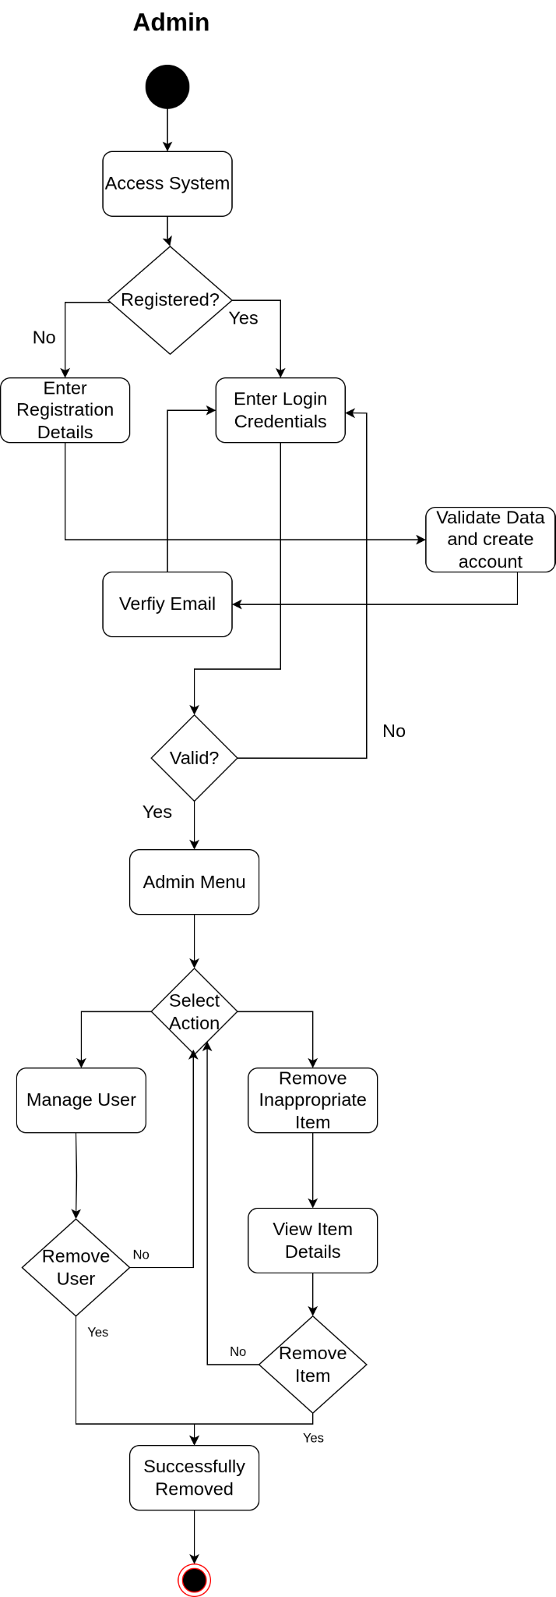

Slide 10
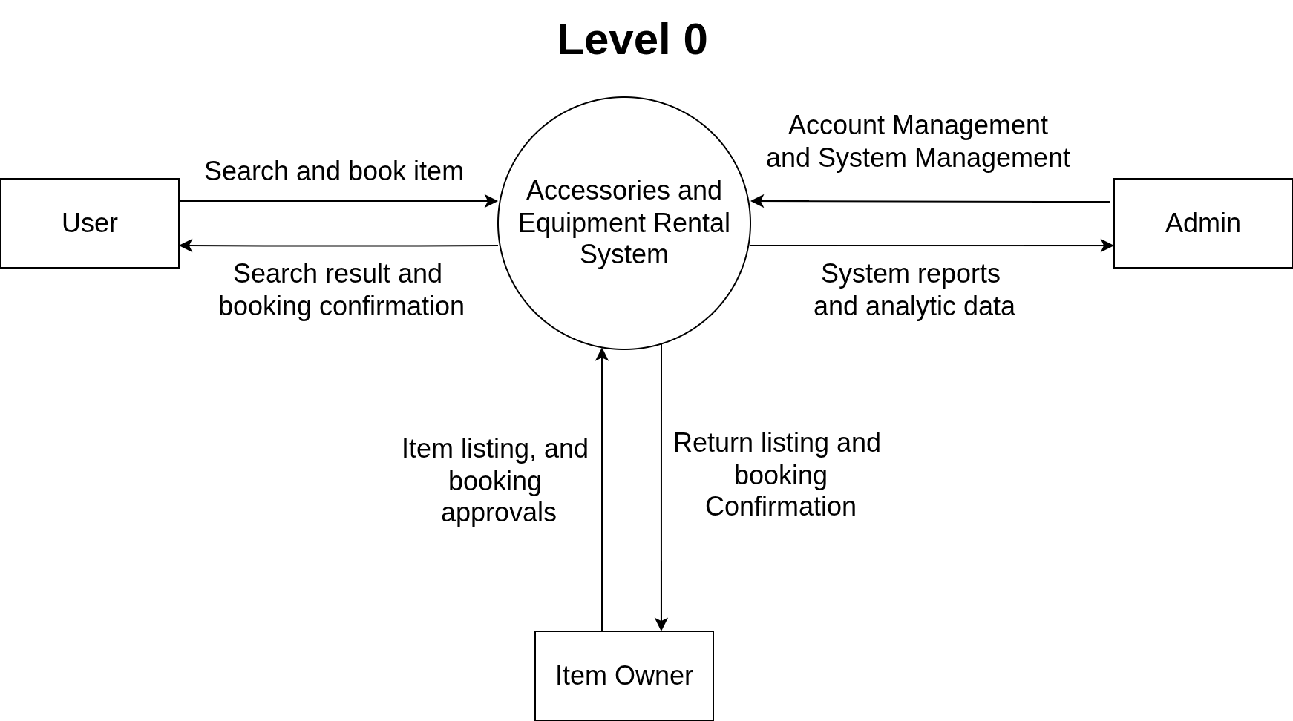
Data Flow Diagram

Slide 11
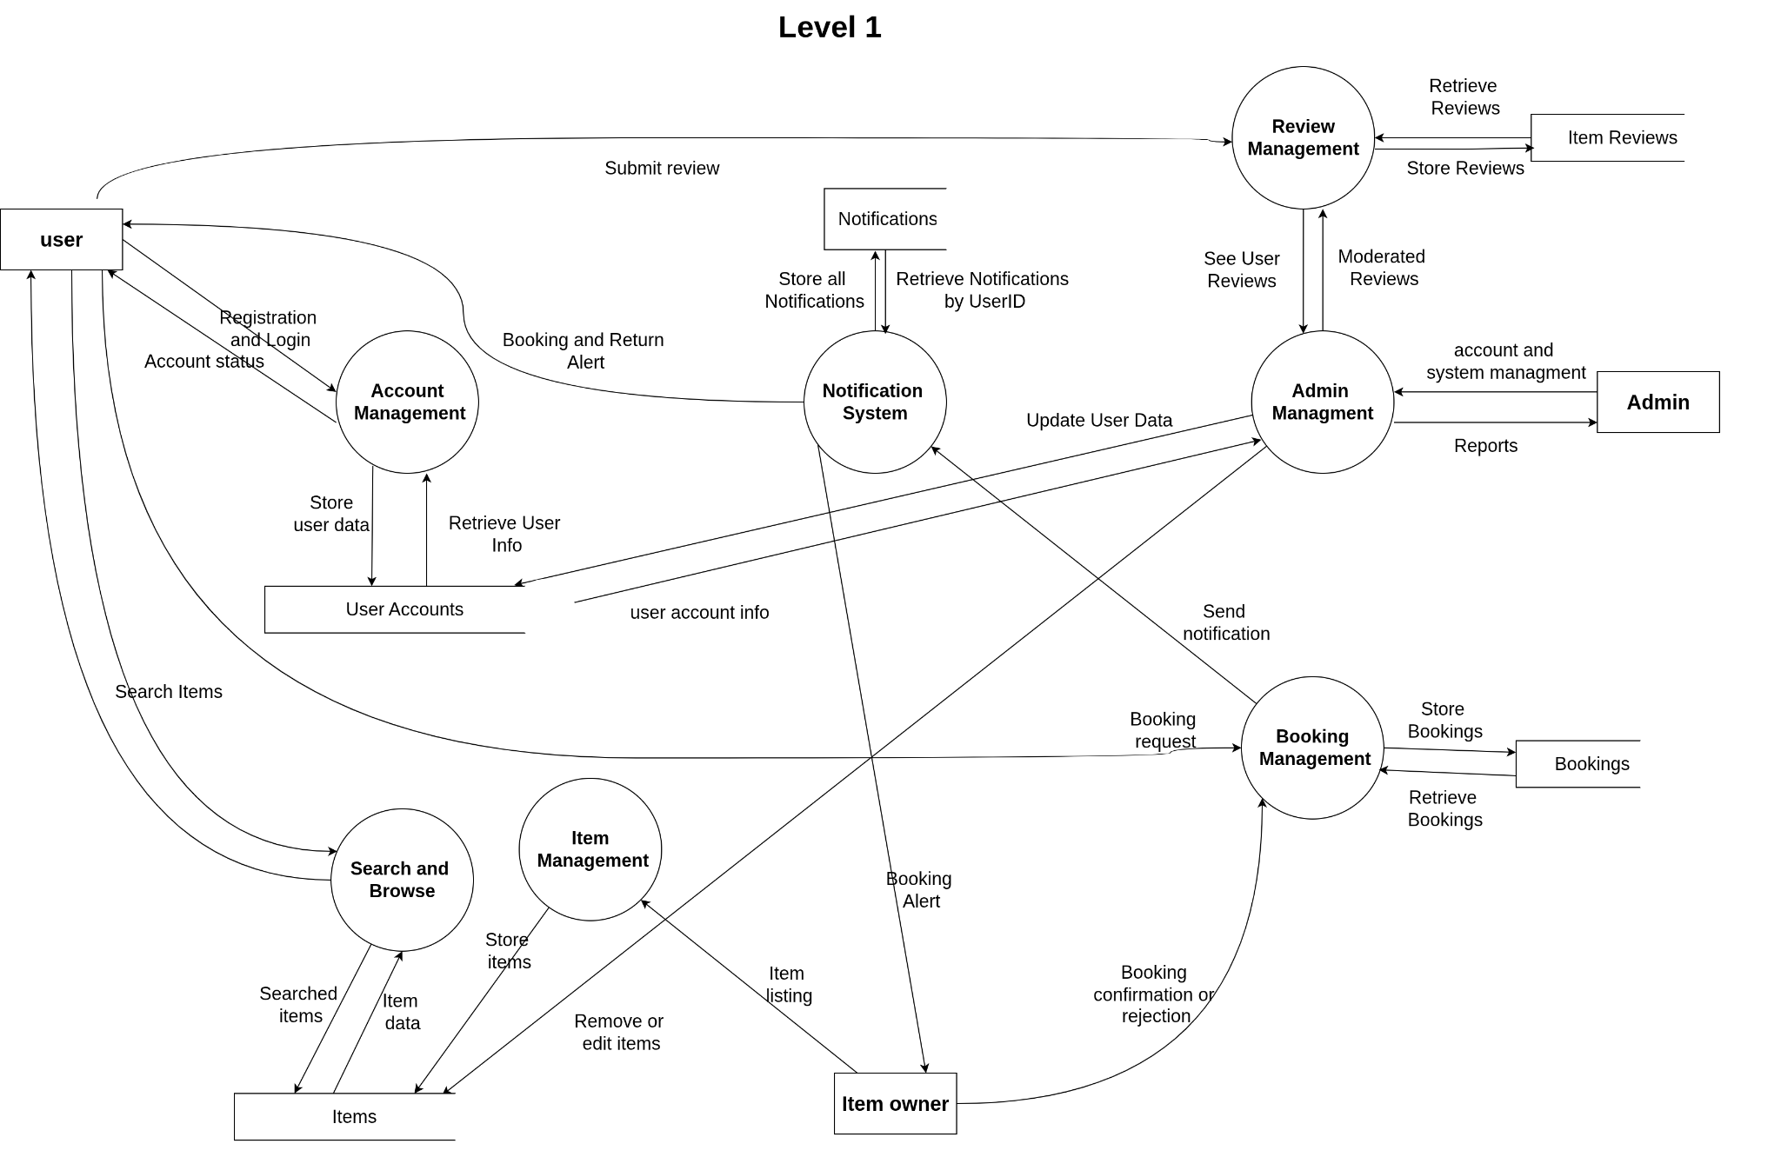

Slide 12
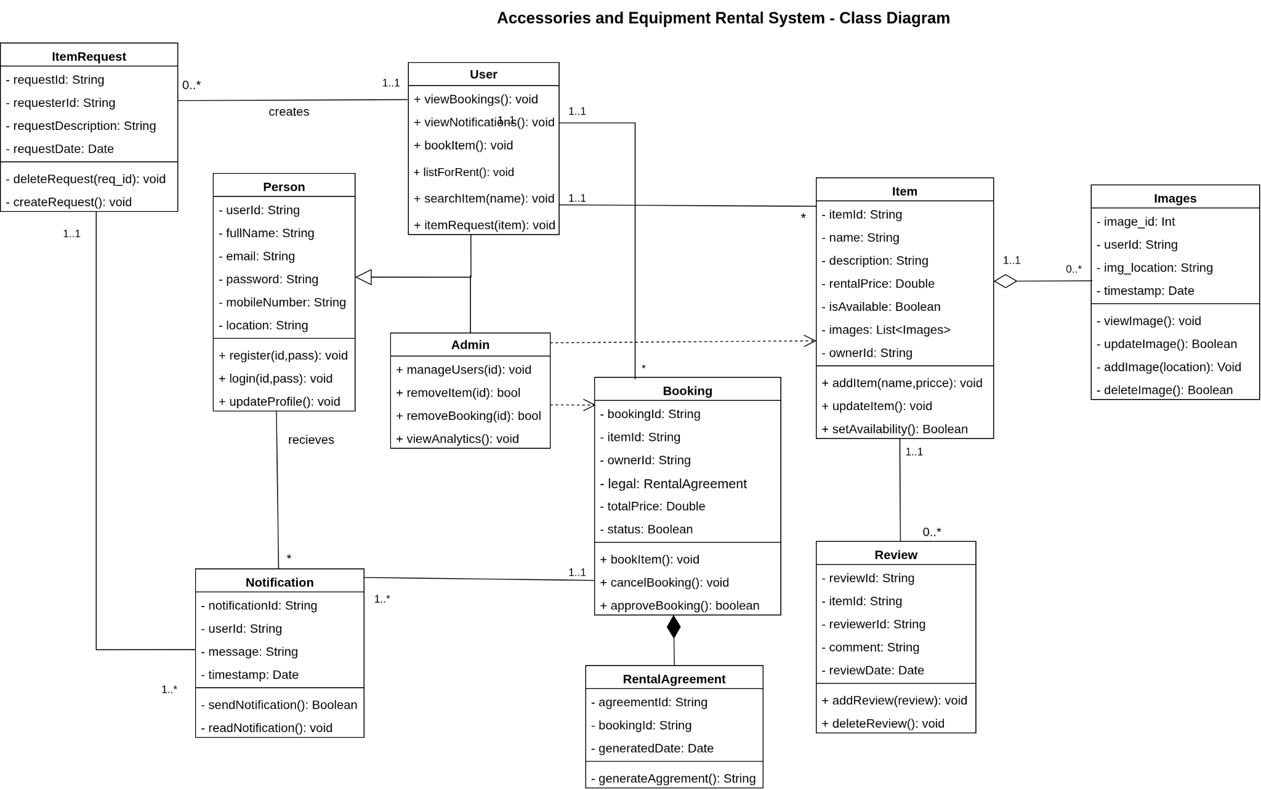

Slide 13
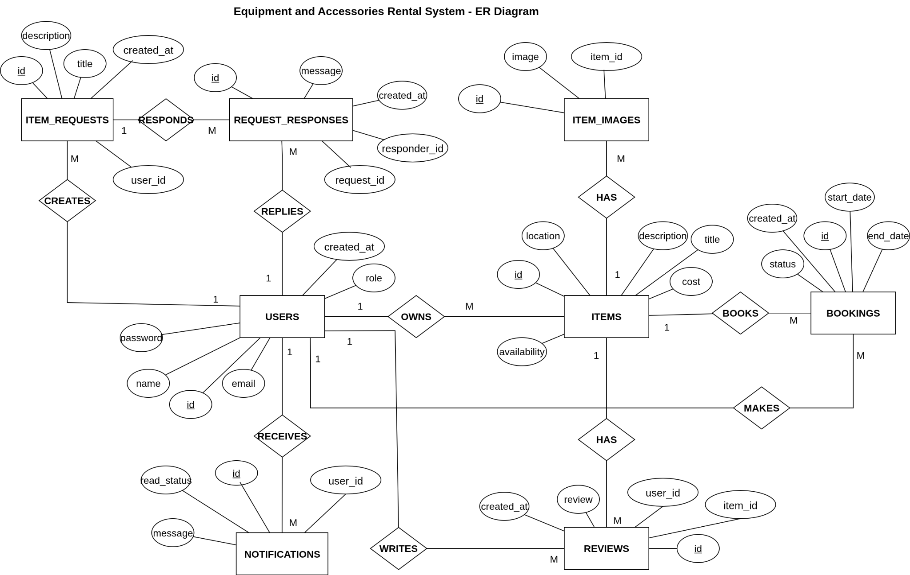

Slide 14
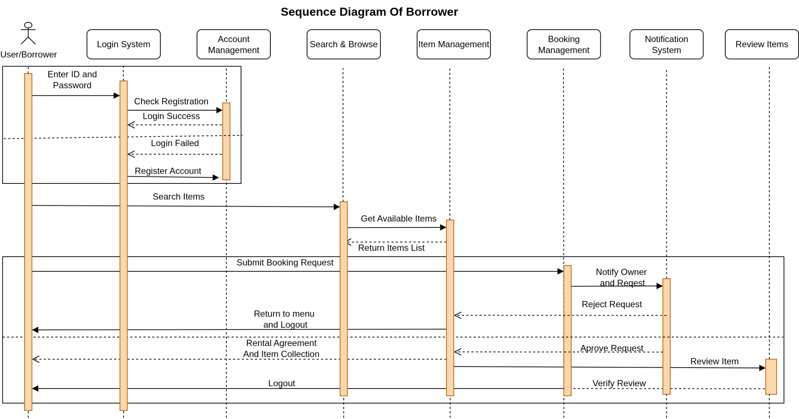

Slide 15
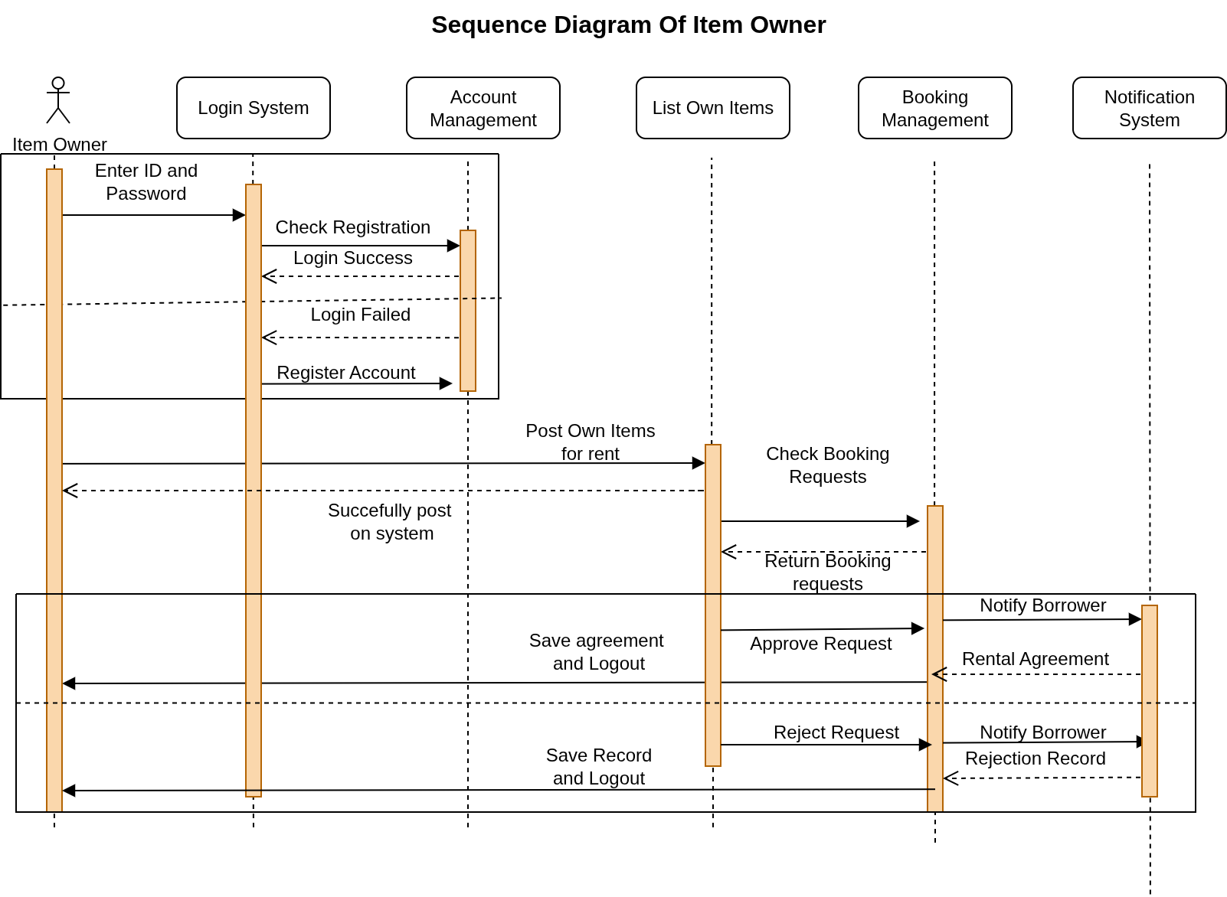

Slide 16
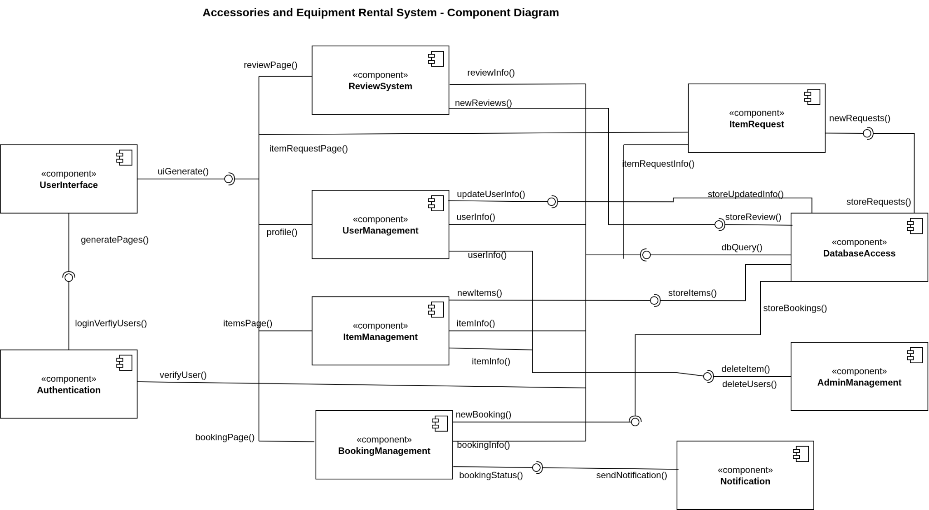

Slide 17
conclusion
System makes borrowing & renting simple and organized
Encourages resource-sharing and reduces waste
Useful for students, communities, and organizations

Slide 18
Thank You

